Slide 1
Black Hole Information
Paradox
Adel Awad
Centre for Theoretical Physics
British University in Egypt

Slide 2

I- Classical Black Holes
1- General Relativity (GR)
GR basic assumptions:
a) Equivalence Principle ⇒ geometrical description of gravity.
b) Principle of General Covariance ⇒ expressing physical laws in tensorial form.
Field Equations:
(geometry) R_{μν}- 1/2 g_{μν} R+ Λ g_{μν} = κ T_{μν} , (matter)
which is similar to Poisson's eqns.
The fundamental quantity here is the metric g_{μν}
ds² = g_{μν} dx ^{μ} dx ^{ν}.
$$^{2}=$$

Slide 3
2- Schwarzschild Solution
Solving vacuum Einstein's Eqns. with spherical symmetry, one obtains what is called Schwarzschild solution;
ds² = - (1-2m/r) dt² + (1-2m/r)⁻¹ dr² + r²(dθ² +sin(θ)² dϕ²
At r_{s}= 2m something goes wrong, it is a horizon! It divides the space into r > 2m and r < 2m.
What happens if we squeeze the matter of a star till it goes inside r_{s}? We get what is called a Black Hole!
.
Schwarzschild
horizon
Curvature singularity
Surf. of the star
Surf. of the star

Slide 4
3- What is a Black Hole
Definition: A black hole is a region in space which has very strong gravitational field such that a light ray emitted from its surface can not escape its gravitational pull.
black hole
Simple classical argument: (Laplace 1798)
v_{esc}= (2 G M/R)^{1/2} ⇒ c = (2 G M/R)^{1/2}
Hawking and Penrose were able to prove that singularities can occur generally in Einstein's G R.
Theorem: The only measurable quantities for a BH are the mass, charge and angular momentum. Notice the analogy between a BH and an elementary particle.

Slide 5
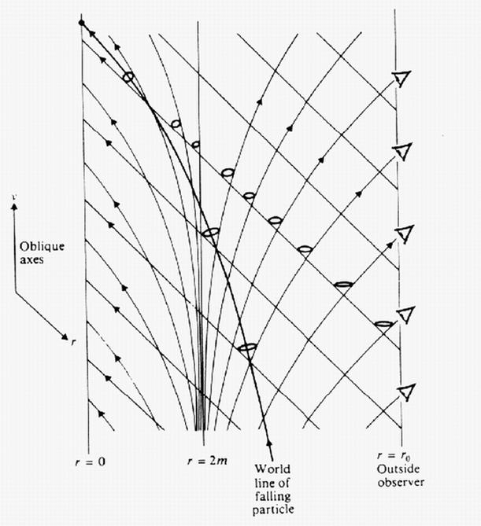
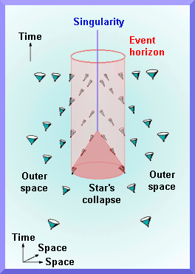
Black Hole in other Coordinates Systems
ds² = - (1-2m/r) dt² + (1-2m/r)⁻¹ dr² + r²(dθ² +sin(θ)² dϕ²
Eddington-Finkelstein coordinates

Slide 6
5- Laws of BH Mechanics
After studying classical BH's for several years relativists were able to write down the following laws;
First Law:
d M = K dA+ Φ dq ⇔ d U = T dS- PdV
Second Law:
d A ≥ 0 ⇔ d S ≥ 0
Bekenstein in 1972 argued that d (S + c A) ≥ 0 and
this can be interpreted as the statistical entropy of a BH.
This is not consistent, since a thermal object must exchange radiations with its surrounding to maintain any thermal equilibrium.

Slide 7
II- Quantum Effects and Black Holes
1- A Quantum Calculation
In 1975, Hawking showed that by quantizing matter fields and keeping gravity classical (semi-classical) a BH must radiates thermally due to quantum effects.
S_{h}=A/4
T_{h}=1/8πM
E field
BH horizon
e ⁻
e ⁺
γ
γ
e ⁺
e ⁻
Strong E field effect
Strong G field effect

Slide 8
Later he argued that this radiation violates unitarity since BH loses information, this is known as "information loss paradox".
|out > = S |in > S can not be unitary?
The consequences are severe, either to modify QM or to show that the evolution is unitary.
Let us try to understand Hawking’s argument more clearly.
M with large S
Thermal radiation

Slide 9

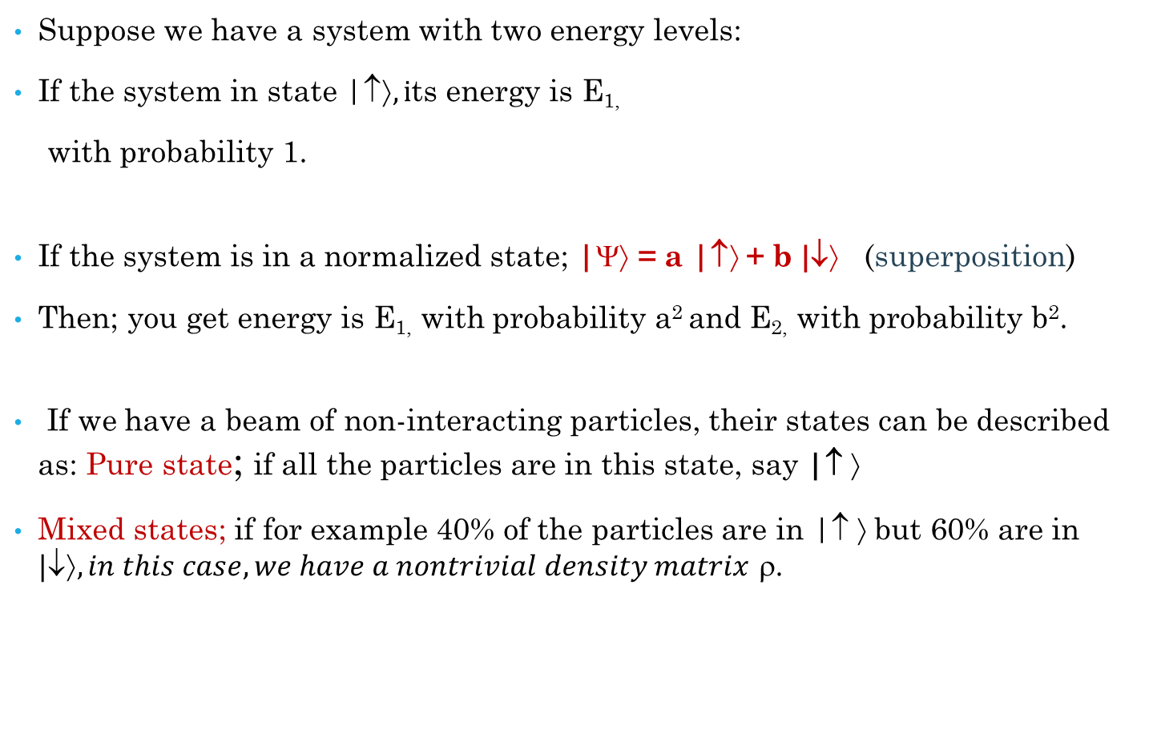

Quantum Mechanics in Nutshell
Suppose we have a system with two energy levels:
If the system in state |↑$, i$ts energy is E_{1,}
with probability 1.
If the system is in a normalized state; |$$ = a |↑$$+ b $\text{|}\text{}$ (superposition)
Then; you get energy is E_{1,} with probability a² and E_{2,} with probability b².
If we have a beam of non-interacting particles, their states can be described as: Pure state; if all the particles are in this state, say |$\text{} $
Mixed states; if for example 40% of the particles are in |$\text{} $ but 60% are in $\text{|}\text{↓}⟩, in this case, we have a nontrivial density matrix$ ρ.
|↑$$
E₁
$\text{|}\text{}$
E₂

Slide 10

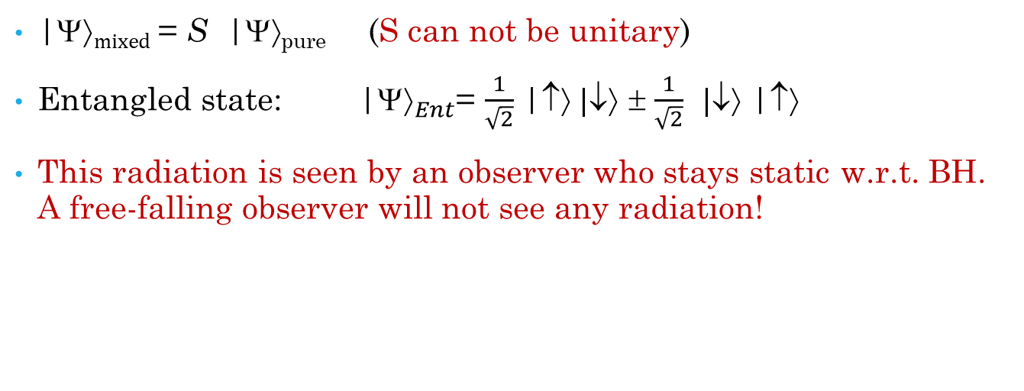
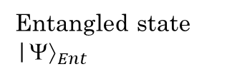
2- Hawking’s Argument
BH horizon
|$$_{pure}
Entangled state |${}_{Ent}$
γ
γ
|$mixed$ = S |$$_{pure} (S can not be unitary)
Entangled state: |${}_{Ent}$= $\frac{1}{\sqrt{2}}$ |↑$ \text{|}\text{}$ ± $\frac{1}{\sqrt{2}}$ $\text{|}\text{}$ |↑$$
This radiation is seen by an observer who stays static w.r.t. BH. A free-falling observer will not see any radiation!

Slide 11
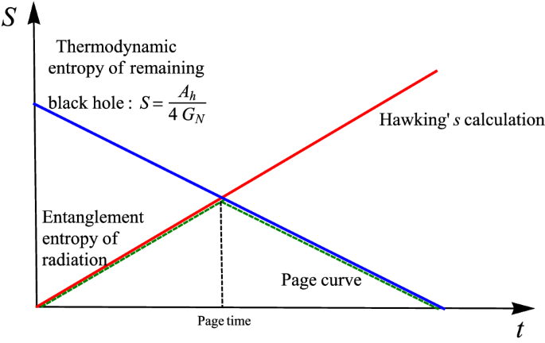
4- Black Hole Complementarity
Don Page studied BH and calculated the time after which a BH starts to release information; t _{Page}~ M³G²
Outside observer will detect entanglement between radiation and an earlier radiation, after this time.
Therefore, in principle one can obtain after PT more information.

Slide 12
Black Hole Complementarity
The above statement with the following assumptions is what we call BH complementarity picture:
Unitarity (information conservation)
Semi-classical approximation is adequate, and we can apply QFT as long as curvature, R<< (l_{p})⁻² =1/G_{N}.
Equivalence principle is valid (in-falling observer see no radiation)

Slide 13
Black Hole Complementarity
outside observer
Matter fall then thermalizes
BH
Both observers will not see any violation of laws of physics
In-falling observer sees nothing unusual and no radiation or drama

Slide 14

Complementarity Argument
earlier radiation before t_{page}
Hawking’s pair
BH
( after t_{page} )

Slide 15
5- Firewall Argument
Firewall argument (AMPS): a simple argument which states that the previous three assumptions of BH complementarity are not consistent (we must give up on one of them)
Monogamy of entanglement: an important property for all quantum systems which ensure that any of two maximally entangled particles cannot be entangled with a third one.
earlier radiation before t_{p}
Hawking’s pair
( entangled )
BH
( entangled )

Slide 16
III- Conclusion
BH information paradox is not fully understood yet! Of course, not as strong as before, since our understanding have developed!
One of the three natural assumptions is wrong. It is not clear what to choose but for AMPS people they choose 2 or 3.
The firewall region could be a result of many things among them nonlocal QFT effects and/or trans-Planckian physics stretched up to the horizon.

Slide 17




Recent Developments
Progress was made in 2019, Penington and Almheiri, Engelhardt, Marolf and Maxfield, were able to compute the entropy of the radiation in specific models of gravity (JT).
These calculations showed that the entropy of this radiation first rises and then falls back to zero.
This is not a full resolution of the information lose paradox, but it is rather an important step towards resolving it.
Penington, Almheiri, Engelhardt, and Maxfield
2021
New Horizon in Physics

