Slide 1
Constraining cosmological parameters using galaxy clusters
Mohamed Elhashash
NRIAG
Chiba University
https://mohammedhamdi2006.wixsite.com/mysite
Notes:
Good afternoon
My name is Mohamed Elhashash, I am interested in studying galaxy clusters, galaxy evolution and Observational Cosmology.
Welcome to my thesis defense.

Slide 2
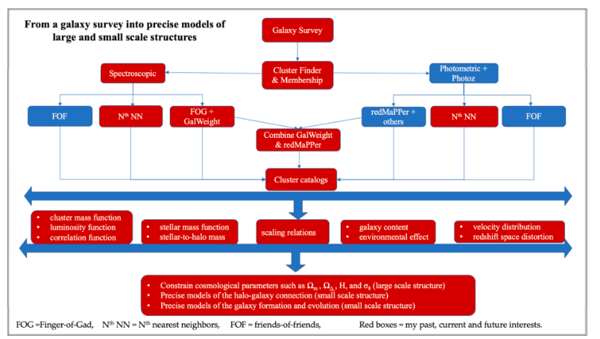
Notes:
This is the outlines of my presentation. A short introduction about galaxy clusters and the motivation of my dissertation, Then I will discuss the results of my papers and my current and future work.

Slide 3
Outlines
Introduction
Paper 1, GalWeight Technique
Paper 2, GalWCat19 spectroscopic SDSS galaxy cluster catalog
Paper 3, constraining cosmological parameters from GalWCat19
Current and future work
Notes:
This is the outlines of my presentation. A short introduction about galaxy clusters and the motivation of my dissertation, Then I will discuss the results of my papers and my current and future work.

Slide 4
Summary
Introducing the GalWeight technique, a new technique for assigning galaxy members of clusters (Abdullah et al. 2018).
Applying the GalWeight technique to the SDSS spectroscopic galaxy survey to construct a catalog of 1800 galaxy clusters (GalWCat19; Abdullah et al. 2020a).
We utilize the GalWCat19 catalog to constrain the cosmological parameters, Ω_{m} and σ₈ (Abdullah et al. 2020b)
Notes:
The dissertation includes three papers
In the first paper, I introduced the GalWeight technique, a new technique for assigning galaxy members of clusters.
In the second paper, I applied the GalWeight technique to the Sloan spectroscopic galaxy survey to construct a catalog of 1800 galaxy clusters.
In the third paper, I used the GalWCat19 Catalog to constrain the cosmological parameters Ω_{m} and σ_{8.}

Slide 5
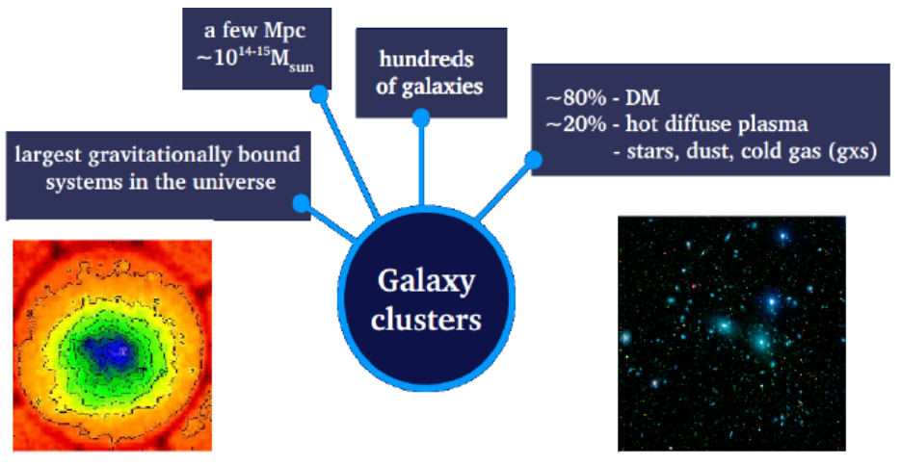
What is a galaxy cluster?
Coma, galaxies
Coma, X-ray
Notes:
So, What is a galaxy cluster?
It is an aggregation of 100 or 1000 of galaxies moving in random directions around the cluster center.
The cluster mass is about 10^14 to 10^15 Msun. The space between galaxies or the intra-cluster medium contains hot gas which emits light mostly in x-rays.
About 80% of the cluster is dark matter. While about 20% are baryons (galaxies , dust, and gas).
The image on the left shows the Coma cluster observed in X-ray band.
And the image on the right shows the distribution of galaxies around the cluster center observed in optical band.

Slide 6
What is a galaxy cluster?
Cluster’s regions:
1. The core
Gaussian random motion
Velocities ~ -3000 to 3000 Km/s
Boundary is the core radius (r_{c})
r_{c} ~ 0.25 Mpc
core
Notes:
Each cluster has three regions, the first one is the core. Galaxies in the core move with random motion with velocities between about -3000 to 3000 km/s relative to the cluster center. The boundary of this region is called the core radius which is about 0.25 Mpc.

Slide 7
What is a galaxy cluster?
Cluster’s regions:
2. Virial region:-
Hydrostatic equilibrium, i.e.
radial motion ≈ tangential motion
The boundary is the virial radius (r_{v})
r_{v} ~ radius at which ρ = 200 ρ_{c} ,
ρ_{c} = critical density of the universe
r_{v} ~ 2.0 Mpc
virial
Notes:
The second one is the virial region. Galaxies are assumed to move with the condition of the hydrostatic equilibrium, which means their radial velocities approximately equal their tangential velocities.
The boundary of this region is called the virial radius that can be defined as the radius at which the cluster density is about 200 times the critical density of the universe.
virial radius extends to about 2 Mpc from the center.

Slide 8
What is a galaxy cluster?
Cluster’s regions:
H₀ r
3. Infall region: -
radial motion towards the center.
r_{t} = radius at which infall velocity
is zero
V_{pec}(r)
V_{inf} (r) = H₀ r – V_{pec}(r)
Infall
Notes:
The third one is called the infall region. Galaxies in this region mostly move radially towards the cluster center.
Generally, galaxies in clusters experience two motions. The first one is the peculiar velocity of the galaxy in the cluster due to its potential well.
The second one is the velocity due Hubble expansion of the universe which goes outwards.
The boundary of this region is the turnaround radius at which the infall velocity is zero or it is the radius at which the peculiar velocity cancels out with the Hubble expansion.

Slide 9
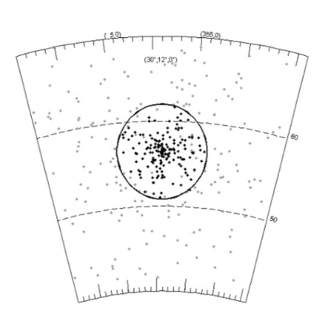
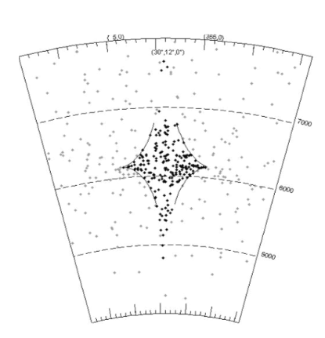
Real Space vs. Redshift Space
Real Space
Redshift Space
true distance of a galaxy from the observer
Line-of-sight velocity with components V_{pec} & V_{Hubble}
RA, Dec (deg)
RA, Dec (deg)
Distance (Mpc)
V_{los} (Km/s)
Notes:
What is the shape of a galaxy cluster?
The left panel shows the distribution of galaxies in real space in which we know the true distances of galaxies from the observer.
The black points represents the galaxy members within the turnaround radius which is shown by the black circle. Therefore, clusters in real space seem like spheres or ellipsoids.
But, we can not measure the true distances to clusters and instead of that we observe redshift or line of sight velocities which is shown in the right panel. We call this space as redshift space.
As shown, the cluster is elongated or distorted along the line of sight due to the Gaussian random motion of the core galaxies. We call this distortion as the Finger-of God effect.
So, all clusters should show this distortion in the redshift space.

Slide 10
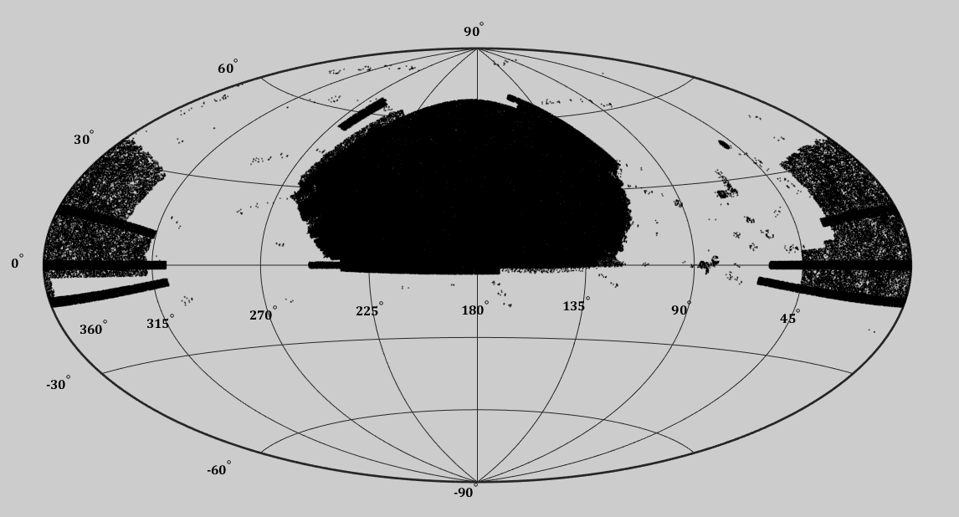
Observations of galaxy cluster
1. Optical Galaxy Surveys such as SDSS, and DES
SDSS spectroscopic galaxy survey-DR13
Notes:
Observation of galaxy clusters
We can identify locations of galaxy clusters from photometric and spectroscopic galaxy surveys, such as SDSS and Dark Energy Survey.
This figure shows the distribution of galaxies of the SDSS on the sky. I will talk about that in more details.

Slide 11
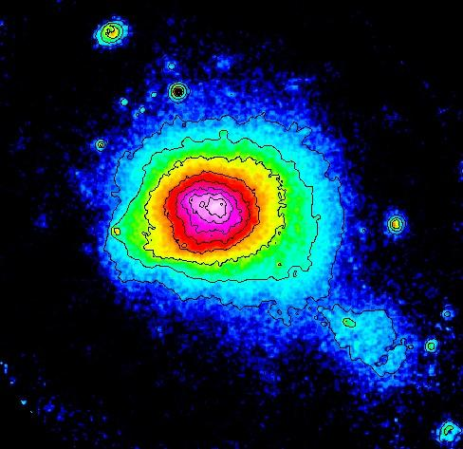
Observations of galaxy cluster
2. X-ray surveys of the hot gas in intra-cluster medium (e.g., Chandra & XMM-Newton satellites)
(e.g., Sarazin 1988, Reichardt+2013)
Notes:
We can also identify galaxy clusters via X-ray surveys of the hot gas located in Intra Cluster medium. We have some x-ray satellites such as Chandra, and XMM.

Slide 12
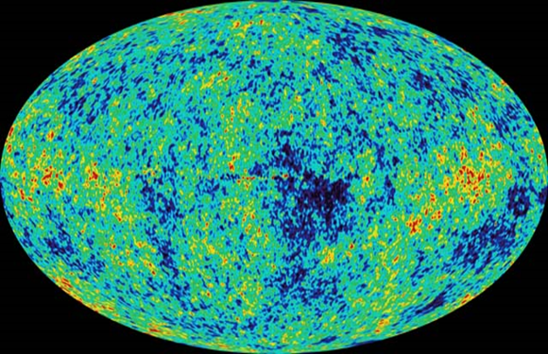
Observations of galaxy cluster
3. Sunyaev-Zel'dovich (SZ) effect:
Distortion of CMB map due to the interaction between the CMB and electrons of the hot gas (e.g., Bocquet+2019)
Notes:
Galaxy clusters can be also detected via the SZ effect, which is the distortion of microwave background radiation map due to the interaction between CMB and electrons of the hot gas located in the Intra cluster medium.

Slide 13
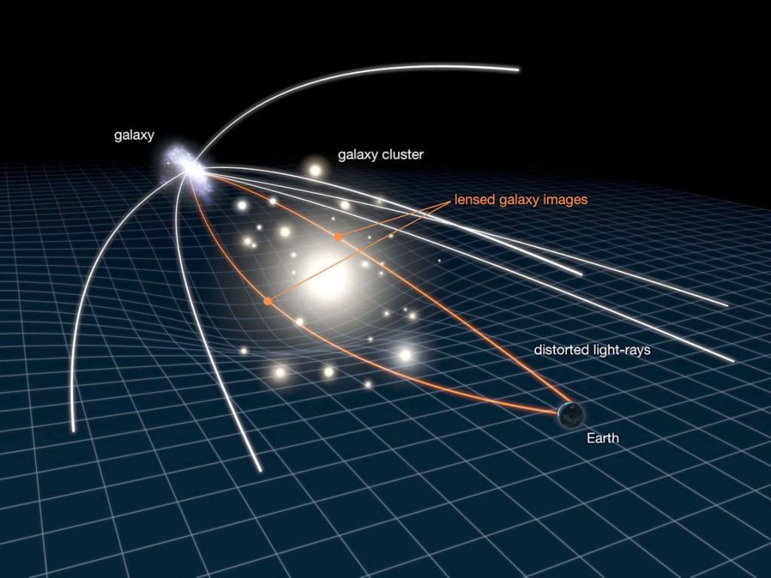
Observations of galaxy cluster
4. Gravitational lensing:
Bending of galaxy light by a cluster located between the galaxy and the observer
(e.g.,Wilson+1996, Holhjem+2009)
Notes:
We can detect galaxy clusters through gravitational lensing, which is the bending of light of very far galaxies by the cluster located between the far galaxies and the observer.

Slide 14
Why Galaxy Clusters?
1. Clusters as cosmological probes:
Cluster Abundance or Cluster Mass Function
Correlation function and Baryon acoustic oscillation
Then,
Constrain cosmological parameters of the universe (Ω_{m}, Ω_{b} , Ω_{ᴧ}, σ₈, h)
Notes:
Why do we study clusters? or, what are the benefits of constructing cluster catalogs?
First, Clusters can be used as cosmological probers.
studying the abundance of galaxy clusters (or the number of clusters) as a function of mass can be used for constraining the cosmological parameters,
Such as the matter density parameter Ω_{m},, the dark energy density parameter Ω_{ᴧ}, and the root mean square mass fluctuation σ8.

Slide 15
Why Galaxy Clusters?
2. Clusters as astrophysical laboratories:
Studying galaxy evolution in clusters (Bayliss+2016, Foltz+2018) and
the galaxy–halo connection (e.g., Wechsler & Tinker 2018)
Then,
Improve the models of formation and evolution of galaxies.
Notes:
Second, we can study the evolution of galaxies in cluster or the environmental effect on the properties of galaxies like galaxy size, stellar mass, and star formation rate.
Then, from these studies we can improve the models of galaxy formation and evolution.

Slide 16
Motivation
Challenge:
Identification of cluster location and the cluster members
Why is it difficult to identify cluster members?
Discussed below
Why is it important to assign the cluster members accurately?
Excluding the true members or including interlopers to clusters lead to Incorrectly estimating cluster masses and consequently incorrectly constraining cosmological parameters.
Notes:
I am studying galaxy clusters and I am interested in galaxy evolution and cosmology since about 10 years. During this time, I found that one of the main challenges that we face is to assign the members of clusters. I will discuss why it is difficult to assign the cluster members later.
But, why is it important to assign the cluster members accurately?
Excluding the true members or including interlopers to clusters lead to incorrectly estimating cluster masses and consequently incorrectly constraining cosmological parameters

Slide 17
Paper 1
GalWeight: A New and Effective Weighting Technique for Determining Galaxy Cluster and Group Membership
(Abdullah, Wilson , Klypin 2018)
Notes:
Let me now start with my first paper, which was published in 2018 in the astrophysical journal.

Slide 18
Paper 1
GalWeight
Identification of the member galaxies of clusters
The Membership Techniques have bias in assigning the member galaxies in clusters
The purpose of the paper:
Introduce a new cluster membership technique and show that it performs better than any of the three most widely used existing techniques
Notes:
As I said, to study galaxy clusters and their dependent astrophysical and cosmological applications with high accuracy, the first and the most important thing is to determine their member galaxies accurately.
There are many membership techniques introduced in the literature to do this task.
But most of these techniques have some issues and have some biases in assigning the member galaxies in clusters.
In this paper, I introduced a new cluster membership technique to assign the member galaxies of a cluster and show that it performs better than any of the three most widely used existing techniques.

Slide 19
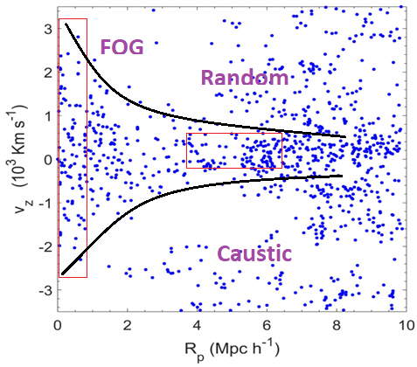
Paper 1
GalWeight
why is it difficult to determine the cluster members?
The cluster shows a caustic shape in the redshift space.
1. The Finger of God of the cluster core.
2. Random motions in the outer regions.
Notes:
So, why is it difficult to determine the cluster membership?
The problem is we do not observe the true distances to galaxies, but we observe the line-of sight velocities of galaxies in the redshift space.
This figure shows the distribution of galaxies of a simulated cluster taken from MultiDark simulation.
The x-axis is the distance from the cluster center and the y-axis represents the velocity in the cluster frame of reference.
The blue points show the distribution of galaxies in the cluster field. So, how can we distinguish between members and outliers from this distribution?
In the redshift space, a cluster appears as a caustic shape as shown by the black lines in the figure, The caustic shape is elongated within the cluster core (due to the finger of god effect) and drops off as we go further away from the cluster center. Note that the caustic does not vanish in the outer regions. Or it still has some effect or width because of the random motion of member galaxies in the infall region due to the presence of substructures, nearby clusters and recent mergers.

Slide 20
Paper 1
GalWeight
How Does GalWeight work?
The idea is to determine a probability (weight) of each galaxy to be a member according to its position from the cluster center in redshift-space.
Weighting functions
Three parameters:
Number density 𝞢(R_{p})
Velocity dispersion σ_{v} (R_{p})
Standard deviation σ_{Rp} (v_{z})
Notes:
How does the GalWeight technique work?
The idea is to determine a probability or weight of each galaxy to be a member according to its position from the cluster center in redshift-space.
This weight is dependent on the internal structure and dynamical status of the cluster. For example, the length of finger of god depends on the density and consequently the cluster mass.
Massive clusters have longer finger of god length more than poor clusters.
In the current version of the technique I selected three parameters that reflect the internal structure and dynamical status of the cluster.
These parameters are the number density profile and velocity dispersion profile as a function distance from the center and the standard deviation as a function of line-of-sight velocity.

Slide 21
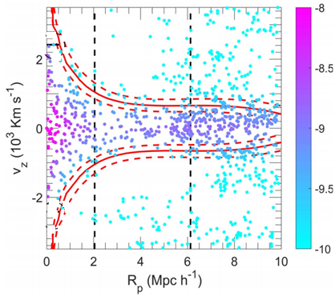
Paper 1
GalWeight
The weight decreases as we go further away from the cluster center along:
The projected distance, x-axis
The line of sight velocity, y-axis
Notes:
Without going over the technical things of the GalWeight technique which described in the paper in detail, we calculate a weight for each galaxy to be a member according to its position in the redshift space as shown in the figure.
This weight decreases as we go further away from the cluster center along the projected distance axis or as we go up and down along the line of sight velocity axis.
The plot shows that a galaxy that is very close to the cluster center has a high weight to be a member, while a galaxy on the upper or lower right corners has a small weight to be a member.
The solid red lines show the optimal contour level or weight which separates the cluster members from the outliers. We call that contour level as the boundary of the cluster. The dashed red lines represent the statistical uncertainty of the boundary.
The two black vertical lines are the virial radius and the turnaround radius of the cluster.
Thus, we define the cluster members as all galaxies enclosed by the cluster boundary and within the turnaround radius.
Once we have the cluster members, we can calculate the dynamical parameters of the cluster such as velocity dispersion and cluster mass.

Slide 22
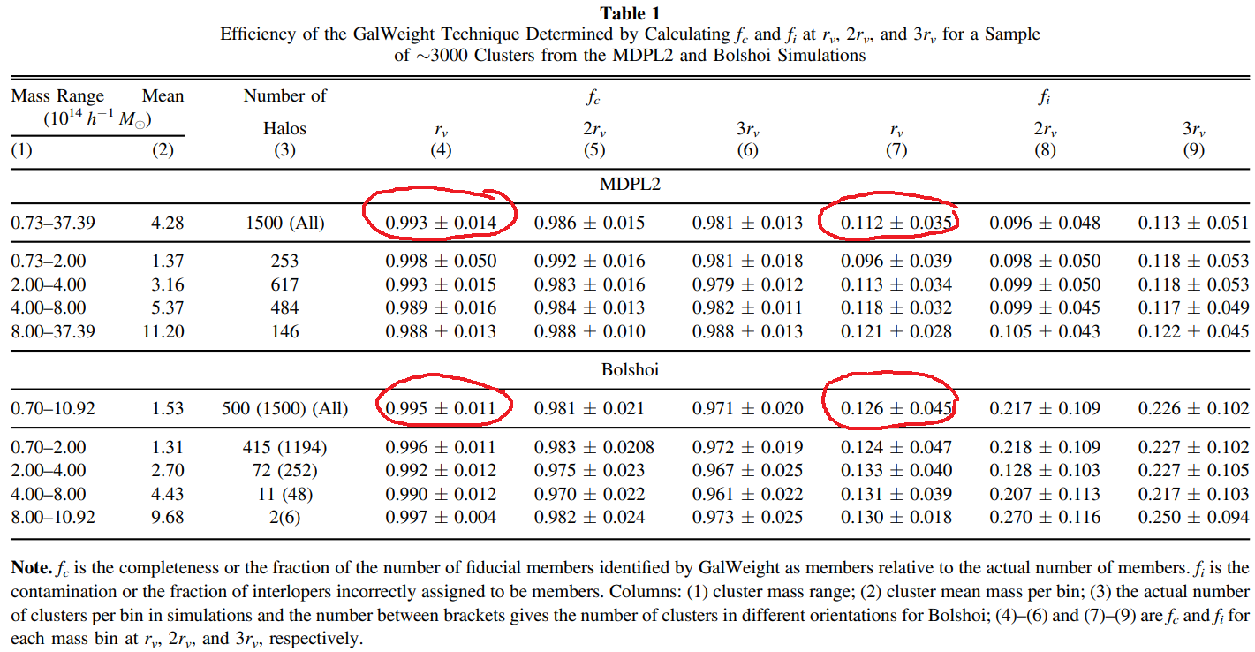
Paper 1
GalWeight
Efficiency of The GalWeight
Application to Multidark (MDPL2) and Bolshoi Simulations
Notes:
After I developed the GalWeight technique I tested its efficiency in recovering the true members of each cluster. To do this task, I applied the technique to the MultiDark and Bolshoi n-body simulations for which we already know the true members of the clusters.
The efficiency is determined by calculating two parameters,
The first one is the completeness which is how many true members are recovered correctly relative the total true cluster members.
The second one is the contamination which is how many interlopers are assigned as members by the technique relative to the true members.
I calculated these two parameters at rv, 2rv and 3rv from the cluster centers.
The completeness is greater than 99% while the contamination is less than 13% within the viral radius. And currently, no membership technique can achieve this high accuracy of recovering cluster members.

Slide 23
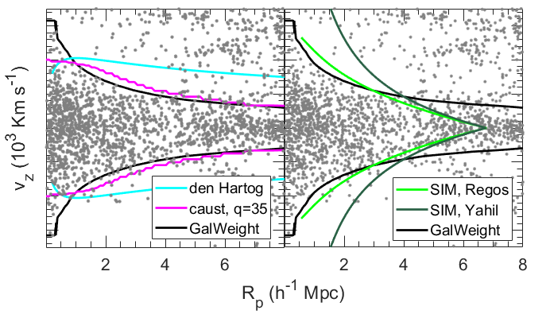
Paper 1
GalWeight
Comparing the GalWeight with other techniques
Den Hartog
(den Hartog+1996)
Caustic (Diaferio1999)
SIM (e.g., Yahil 1985, Regos 1989)
Notes:
Here is comparison between the GalWeight technique and three membership techniques which are used extensively in the literature. The figure shows the redshift space of the Coma cluster.
The black lines represent the application of the GalWeight, which successfully describe the Finger of God effect of the core galaxies and at the same time the random motion of galaxies in the infall region.
The cyan lines show the application of the den Hartog method. This method could not recover the cluster shape accurately.
The pink lines show the application of the Caustic technique. This technique could describe the random motion of galaxies in the infall region, but it could not describe the finger of god effect
Finally, light and dark green lines show the applications of two spherical infall models which might able to describe the finger of god effect but could not describe the random motion in the infall region.

Slide 24
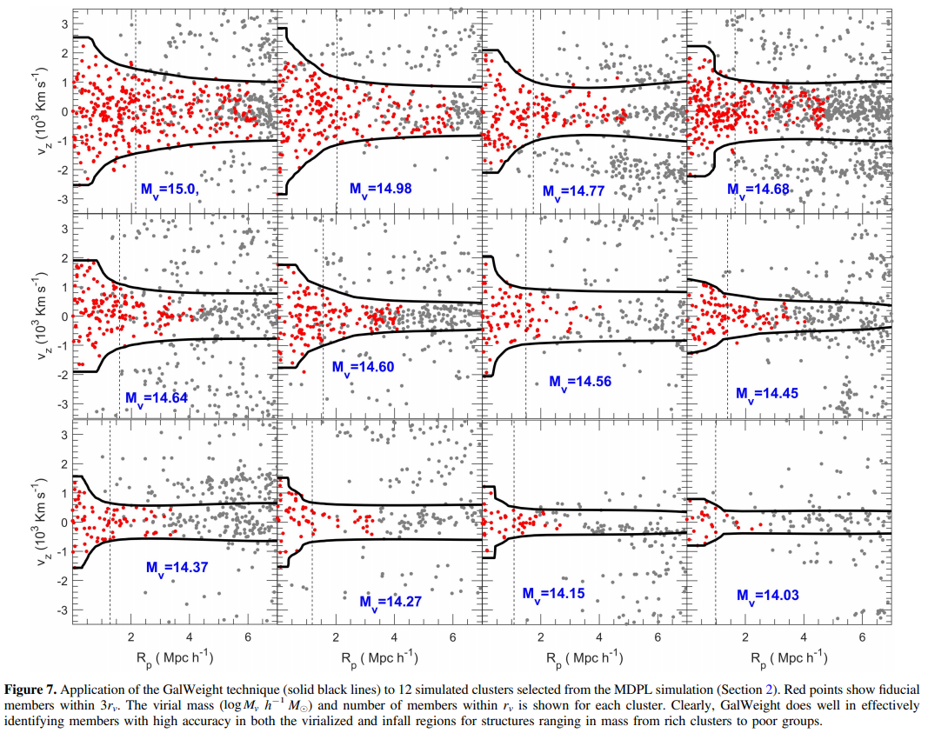
Paper 1
GalWeight
Application to MDPL2 clusters
Notes:
The figure shows the application of the GalWeight technique to 12 simulated clusters with different masses taken from the MultiDark simulation.

Slide 25
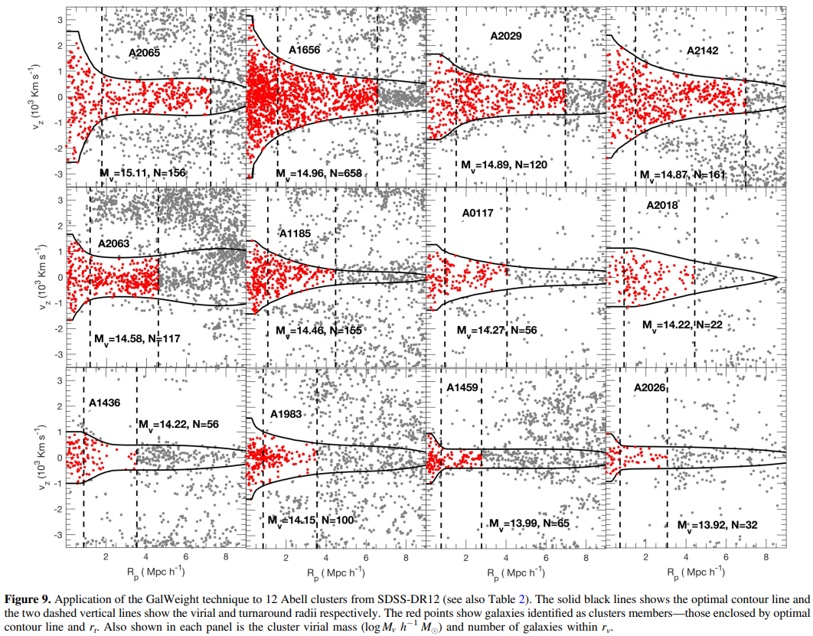
Paper 1
GalWeight
Application to SDSS clusters
Notes:
Also, this figure shows the application of the GalWeight technique to 12 observed clusters taken from the SDSS-DR13.

Slide 26
Paper 1
GalWeight
Advantages:
GalWeight is designed to maximize the number of bona fide cluster members while minimizing the number of interlopers.
GalWeight can be applied to both massive galaxy clusters and poor galaxy groups.
GalWeight is effective in identifying members in both the virial and infall regions with high efficiency.
Notes:
Finally, the advantages of using the GalWeight technique are
First, GalWeight is designed to maximize the number of true cluster members while minimizing the number of interlopers.
GalWeight can be applied to both massive galaxy clusters and poor galaxy groups.
GalWeight is effective in identifying members in both the virial and infall regions with high efficiency.

Slide 27
Paper 2
GalWeight Application: A Publicly Available Catalog of Dynamical Parameters of 1800 Galaxy Clusters from SDSS-DR13, (GalWCat19)
(Abdullah, Wilson , Klypin+2020a)
Notes:
Let’s go now to the second paper. This paper was published in the Astrophysical Journal Supplements at the beginning of this year.

Slide 28
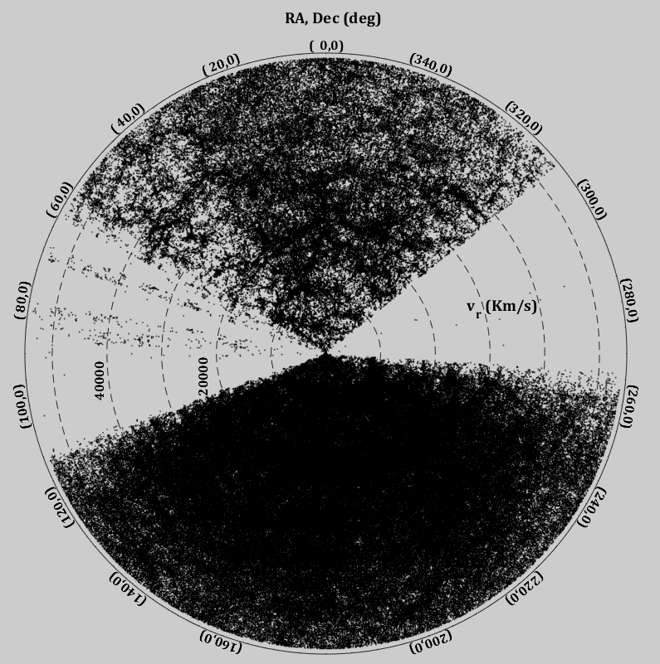
Paper 2
GalWCat19 Catalog
The purpose of this paper is to introduce a spectroscopic cluster catalog from SDSS-DR13 spectroscopic data set.
The goals:
Find clusters’ locations using the Finger-of God effect.
Apply GalWeight to assign clusters’ membership.
Calculate the dynamical properties and the mass of each cluster in the catalog.
How can we locate clusters?
SDSS-DR13 Spectroscopic Galaxy Survey
Notes:
The purpose of this paper is to introduce a galaxy cluster catalog from SDSS-DR13 spectroscopic data set.
The goals of this paper are:
First, finding clusters’ locations using the Finger-of God signature of clusters in the redshift space.
Second, applying the GalWeight technique to assign clusters’ membership.
Third, calculating the dynamical properties and mass of each cluster in the catalog.
The figure on the right shows the distribution of galaxies of SDSS in the redshift space.
The question is how can we locate or find the clusters from this distribution?

Slide 29
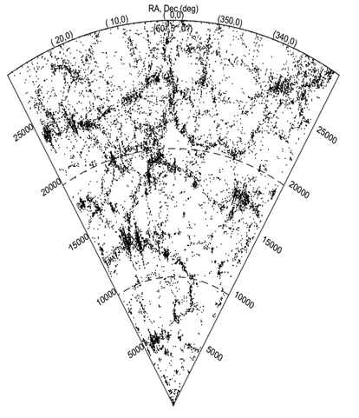
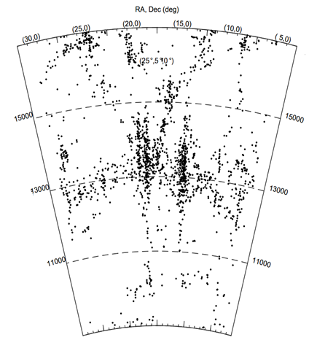
Paper 2
GalWCat19 Catalog
V_{los} (Km/s)
V_{los} (Km/s)
Notes:
When we look at a small part of the previous figure, we can see the details of the structures in the redshift space. Within the red box, there are two fingers shown clearly. Each finger represents a cluster. We can zoom in more to see all details as shown in the right panel. Once we find the cluster position, we can apply the GalWeight technique to obtain the cluster members. The technical steps of finding the locations of clusters are described in the paper.

Slide 30

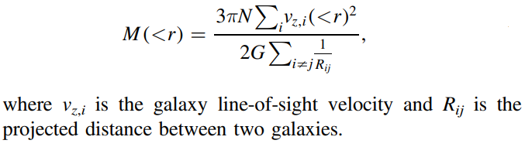

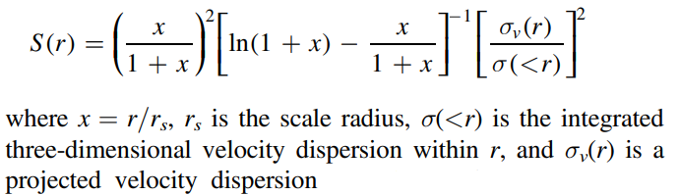
Cluster mass
Paper 2
Virial Mass Estimator
applied to an isolated and Hydrostatic equilibrium system
But,
Cluster are extended and not isolated objects
Apply a correction: Surface Pressure term (The & White 1986)
Notes:
Now, after we located the positions of the clusters and their members, we can calculate the dynamical properties of each cluster. The mass is calculated using the virial mass estimator. The virial mass estimator can be applied to isolated and hydrostatic equilibrium systems for which the potential energy of a galaxy equals two times its kinetic energy.
So the mass can be calculated from the formula shown here, where N is the number of galaxies, v_{z} is the line-of sight velocity of each galaxy and R is the projected distance between each galaxy pairs. The problem is galaxy clusters are not isolated and extended beyond the virial region. In that case, the virial mass estimator will overestimate the cluster mass and we should correct for this effect which is called the surface pressure term. Once we apply this correction, we have the cluster mass and then we can calculate all other dynamical parameter of the cluster such as virial radius, optical richness, and velocity dispersion.

Slide 31
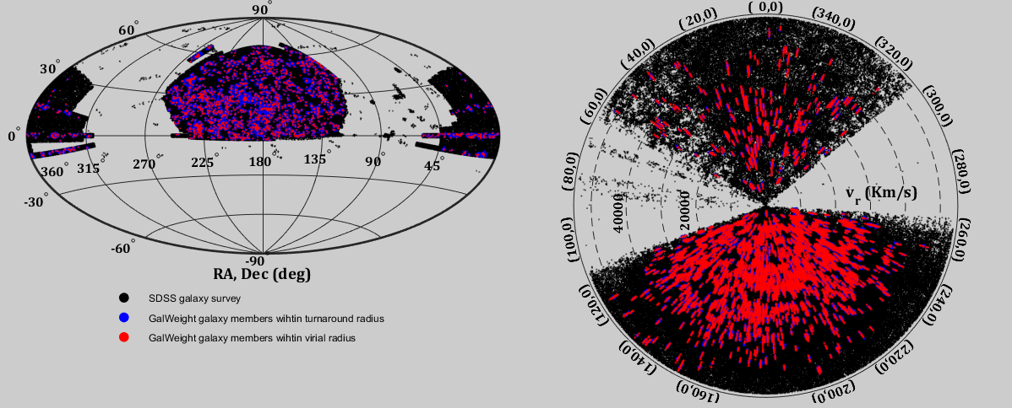
GalWCat19 cluster catalog
Paper 2
GalWCat19 introduces two catalogs for
(i) 1800 clusters with their dynamical parameters (ii) Cluster members
Notes:
Finally, after applying the procedure of finding cluster locations, applying GalWeight to assign cluster membership and calculating cluster dynamics, we obtained 1800 galaxy cluster
The distribution of member galaxies of the 1800 clusters are shown on the sky in the left panel and on the redshift space in the right panel. The red points represent the members within the virial radius, and the blue points represent the members within the turnaround radius.

Slide 32
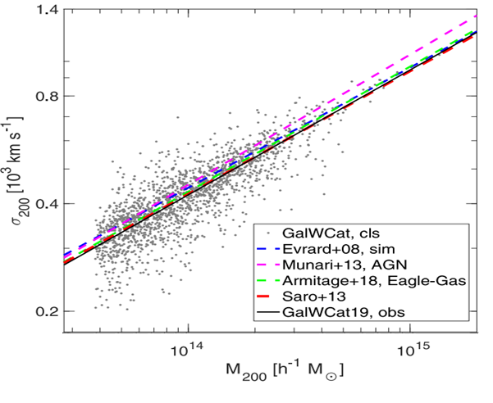
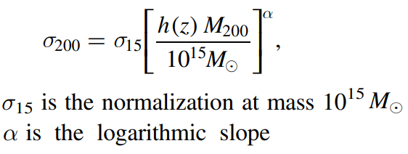
GalWCat19 cluster catalog
Paper 2
The scaling relation
the velocity dispersion and cluster mass at the virial radius
σ₁₅ = 946±52 km/s
α = 0.349±0.142 km/s
Notes:
As an application of the GalWCat19 cluster catalog, I derived the scaling relation between the cluster velocity dispersion and mass at the virial radius. The gray points show the clusters, and the solid black line represents the best-fit relation of the Equation shown here. sigma_15 is the normalization at mass 10^15 M_sun and alpha is the slope of the relation.
The blue, purple, green, and red dashed lines show the relations derived from cosmological simulations as you see in the legend. As shown, the GalWeight relation matches the models well, which indicates the accuracy of GalWeight to assign cluster membership and consequently determine cluster masses

Slide 33
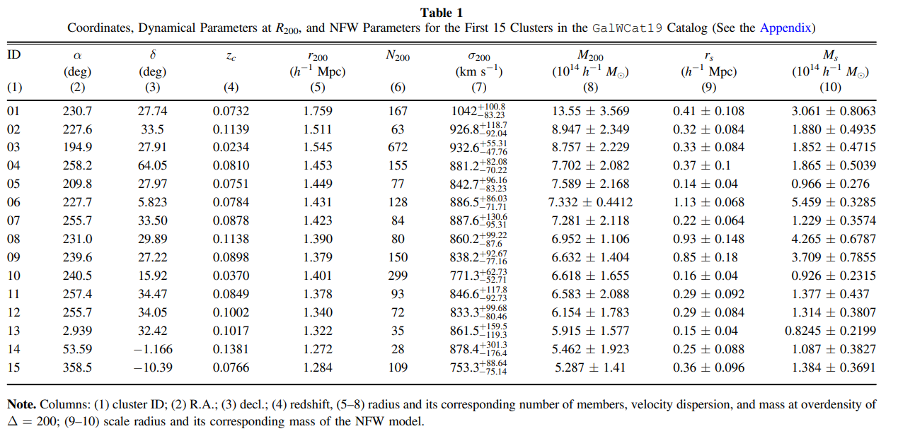
GalWCat19 cluster catalog
Paper 2
GalWCat19 was published on
http://vizier.u-strasbg.fr/viz-bin/VizieR?-source=J/ApJS/246/2
GalWCat19 introduces two catalogs:
1. Clusters with their dynamical parameters
2. cluster members
Notes:
The results of GalWCat19 are published online on my website and Strasbourg astronomical Data Center (CDS) website. The results introduce two catalogs, the first one is the catalog of the 1800 clusters including the locations of the cluster centers, and their dynamical properties at different radii.
The second catalog provides the coordinates of each member galaxy and the ID of the cluster that the galaxy belongs to.
The table here shows the properties of the first 15 clusters at an overdensity of 200 as well as the scale radius and scale mass of the NFW model.

Slide 34
Paper 3
Cosmological Constraints on Ω_{m} and σ8 from Cluster Abundances using the GalWCat19 Optical-Spectroscopic SDSS Catalog
(Abdullah, Wilson , Klypin 2020b)
Notes:
As a cosmological application, I used the GalWCat19 spectroscopic cluster catalog to constrain the cosmological parameters. The paper is accepted for publication in the astrophysical journal.

Slide 35
Paper 3
Constraining on Ω_{m} and σ₈
The purpose of this paper is to constrain the cosmological parameters of
1. The matter density of the universe (Ω_{m}),
(dark matter+baryons)
2. The root mean-square mass (density) fluctuations on the scale of 8 Mpc (σ₈)
Notes:
The purpose of this paper is to Constrain the cosmological parameters of
The matter density of the universe (Ω_{m}) which includes dark matter and baryons
the root mean-square mass fluctuation on the scale of 8 Mpc (σ₈)

Slide 36



Cluster Formation
Paper 3
Galaxy clusters arise from rare high peaks of the initial density fluctuation field.
Density contrast or overdensity
$$δ\left(r\right)=\frac{ρ\left(r\right) − <ρ>}{<ρ>}$$
Or equivalently
$$δ\left(r\right)=\frac{M\left(r\right) − <M>}{<M>}$$
$$M=\frac{4π}{3} r^{3}ρ$$
where
These peaks grow with time through the gravitational instability to form the present galaxy clusters
Notes:
So , how galaxy clusters formed?
Galaxy clusters arise from rare high peaks of the initial density fluctuation field of density contrast delta (r) equals the density within a radius r subtracted from the background average density and divided by the average density.

Slide 37
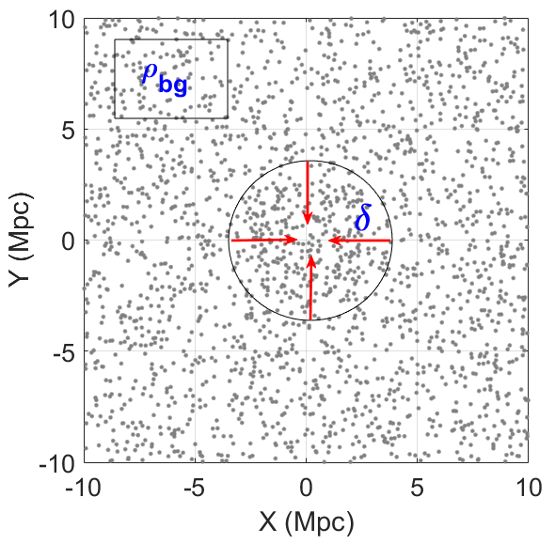
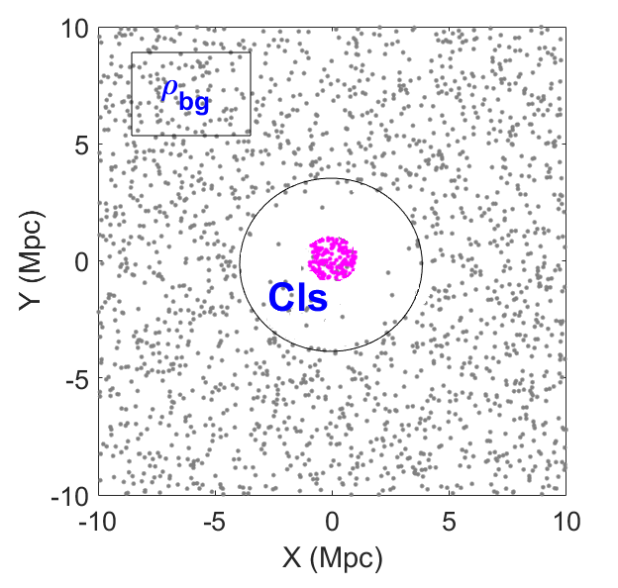
Background
Paper 3
These peaks grow with time through the gravitational instability to form the present galaxy clusters
Density perturbation
Grav. Instability
Notes:
Let’s assume we have an overdensity or density perturbation within the circular region shown here. This overdensity will grow up with time through the gravitational instability to form a galaxy cluster shown as the pink clump on the right. Also, let’s assume we have region within the rectangle shown on the upper left corner with density equals the background density. This region will not grow up with time and still the same. We do not expect to have a cluster at this region.

Slide 38
Background
Paper 3
The question is:
How many clusters we have in the Universe ?
Cosmological models can predict the number of clusters above a certain mass threshold, N(>M) =???.
This number of clusters depends on the cosmological parameter of
1. The matter density of the universe (Ω_{m})
2. The rms mass fluctuations on the scale of 8 Mpc (σ₈)
Notes:
The question is:
How many overdensities (or clusters) we have in the Universe ?
Cosmological models can predict the number of clusters above a certain mass threshold.
This number of clusters depends on the cosmological parameter of
1. The matter density of the universe (Ω_{m})
2. The rms mass fluctuations on the scale of 8 Mpc (σ₈)

Slide 39
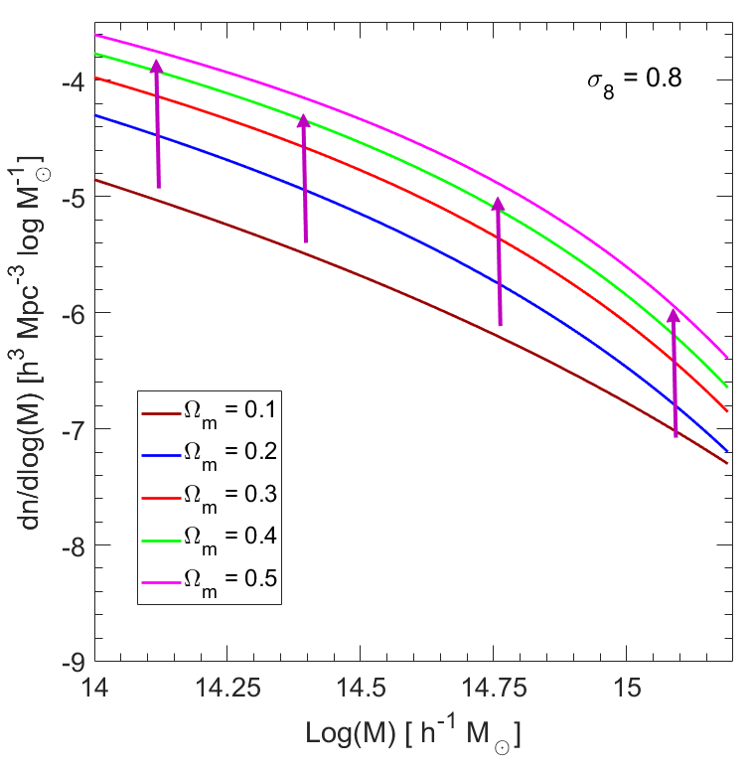
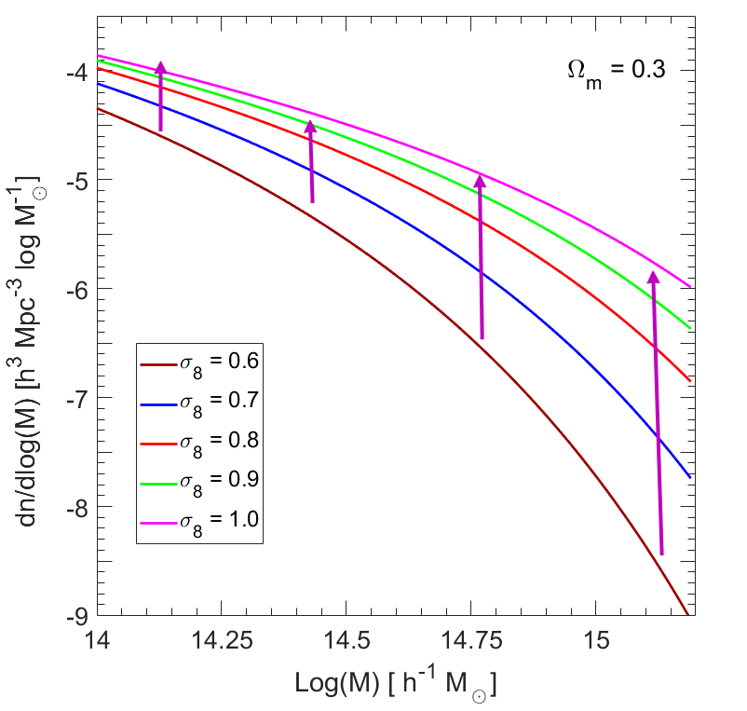
Background
Paper 3
The Effect of varying Ω_{m} and σ₈ on the shape of the HMF
Or, The dependence of the HMF on Ω_{m} and σ₈
Notes:
How do Ωm and σ8 contribute individually to the abundance of galaxy clusters?
The left panel shows the abundance of galaxy clusters for five different values of Ωm= [0.1 0.2 0.3 0.4 0.5] with fixing σ8 = 0.8. As shown, increasing the matter density of the universe will increase the number of clusters of all masses with almost the same rate at
The right panel shows the abundance of galaxy clusters for five different values of σ8= [0.6 0.7 0.8 0.9 1.0] with fixing Ωm= 0.3. As shown, increasing the rms mass fluctuation increases the number of high-mass clusters more than number the low-mass clusters. This is because the high initial overdensity regions will grow faster and accrete or collect more matter due to its high gravity more than the low initial overdensity regions. In other words, σ8 is very sensitive to the high-mass end of the abundance of galaxy clusters.
So, the abundance of galaxy clusters depends strongly on Ωm and σ8.

Slide 40
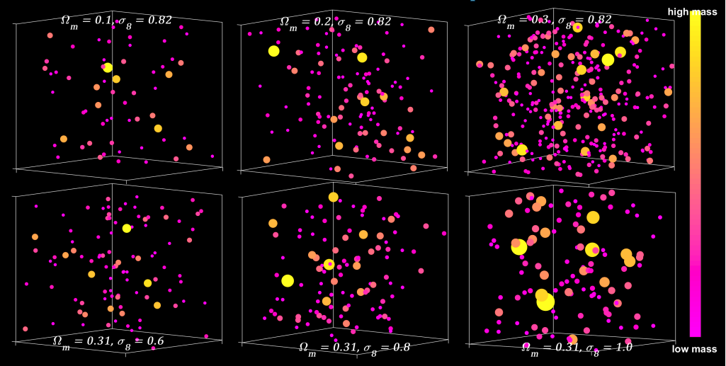
Background
Paper 3
The Effect of varying Ω_{m} and σ₈ on the shape of the HMF
Or, The dependence of the HMF on Ω_{m} and σ₈
Notes:
How do Ωm and σ8 contribute individually to the abundance of galaxy clusters?
The left panel shows the abundance of galaxy clusters for five different values of Ωm= [0.1 0.2 0.3 0.4 0.5] with fixing σ8 = 0.8. As shown, increasing the matter density of the universe will increase the number of clusters of all masses with almost the same rate at
The right panel shows the abundance of galaxy clusters for five different values of σ8= [0.6 0.7 0.8 0.9 1.0] with fixing Ωm= 0.3. As shown, increasing the rms mass fluctuation increases the number of high-mass clusters more than number the low-mass clusters. This is because the high initial overdensity regions will grow faster and accrete or collect more matter due to its high gravity more than the low initial overdensity regions. In other words, σ8 is very sensitive to the high-mass end of the abundance of galaxy clusters.
So, the abundance of galaxy clusters depends strongly on Ωm and σ8.

Slide 41
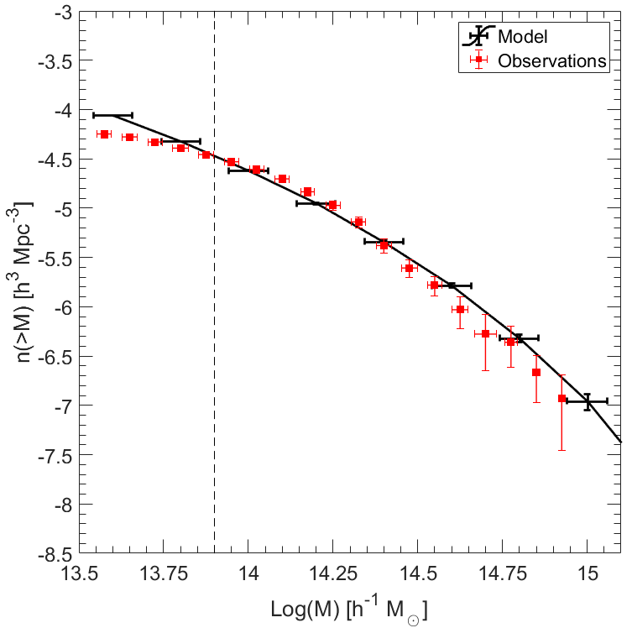
Background
Paper 3
The idea is to compare the abundance of galaxy clusters obtained from the GalWCat19 galaxy cluster catalog with the expectation obtained from cosmological models.
Notes:
So, how can we constrain the cosmological parameters?
The idea is to compare the abundance of galaxy clusters obtained from the GalWCat19 galaxy cluster catalog shown as red line in the figure with the expectation obtained from cosmological models shown as the black line.

Slide 42
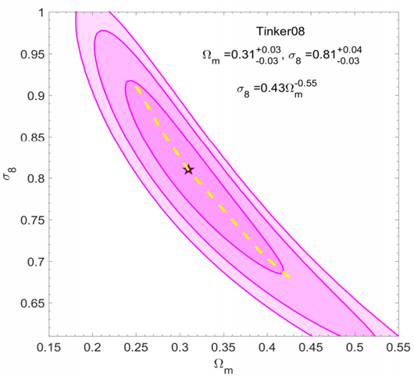
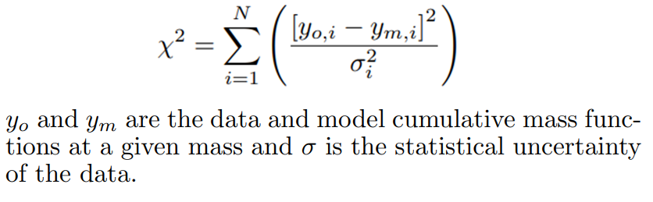
Constraining Ω_{m} and σ₈
Paper 3
To constrain Ω_{m} and σ₈ we use a standard χ² procedure
We obtain
Ω_{m}=0.31±0.032(stat)±0.041 (syst)
σ₈=0.81±0.031(stat)±0.035 (syst)
Notes:
Using the chi squared procedure, I compared the abundance of galaxy clusters obtained from the GalWCat19 with 10000 models by allowing Ωm to range between [0.1, 0.6] and σ8 between [0.6, 1.1]. This figure show the likelihood contour map of χ2 in σ8-Ωm plane. The black star represents the best-fit point for Ωm and σ8 which minimizes χ2 value. Ellipses represent 1σ, 2σ, and 3σ confidence levels. The dashed yellow line represents degeneracy or the relationship between σ8 and Ωm.
The best-fit parameters are Ω_{m} = 0.31±0.032(stat)±0.041 (syst)
and σ₈=0.81±0.031(stat)±0.035 (syst)

Slide 43
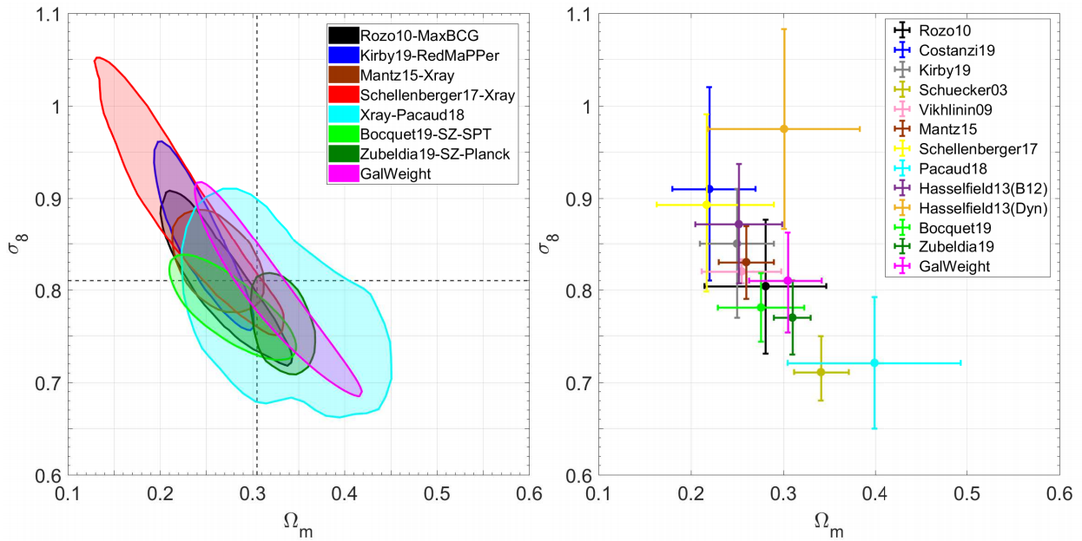
Constraining Ω_{m} and σ₈
Paper 3
Comparison with cluster abundance measurements from other surveys
Ω_{m} and σ₈ obtained
from different cluster abundance surveys are in tension with each other.
WHY???
Notes:
Comparison with cluster abundance measurements from other surveys
The left panel introduces the 68% confidence level derived from our catalog (pink contour) in comparison to the results obtained from other cluster abundance studies. Some of these studies use optical photometric catalogs, some use X-ray cluster catalogs and others use SZ-detected clusters. The Right panel shows the uncertainties on Ωm and σ8 for each of these studies. It is clear that the constraints on Ωm and σ8 from cluster abundance studies are in tension with each other. For example Ωm varies between 0.2 to 0.4 and σ8 varies between 0.7 to 1.0.
Why do we have this tension or scatter?

Slide 44
Constraining Ω_{m} and σ₈
Paper 3
Comparison with cluster abundance measurements from other surveys
The answer is:
The discrepancies in estimating cluster masses
But, why do we trust or believe in our results?
Notes:
The answer is most, if not all, of these studies do not calculate cluster masses directly but infer the masses indirectly from other observables which scale tightly with cluster mass such optical richness, x-ray luminosity or temperature.
So, why do we trust or believe in our results?

Slide 45
Constraining Ω_{m} and σ₈
Paper 3
why do we trust or believe in our results?
GalWCat19 is derived spectroscopic not photometric dataset.
The membership was assigned by GalWeight.
The cluster masses were calculated individually from the virial mass estimator
The size of GalWCat19 is one of the largest spectroscopic samples to be a fair representation of the cluster population
Our results are consistent with the results obtained from non-cluster abundance probes (next)
Notes:
GalWCat19 cluster catalog is derived spectroscopic data set of Sloan not from photometric.
The cluster membership was assigned by applying the GalWeight technique with high accuracy in correctly assigning cluster membership.
The cluster masses were calculated individually from the virial mass estimator
the size of GalWCat19 is one of the largest available spectroscopic samples to be a fair representation of the cluster population
Our results are consistent with the results obtained from non-cluster abundance probes as I will discuss next

Slide 46
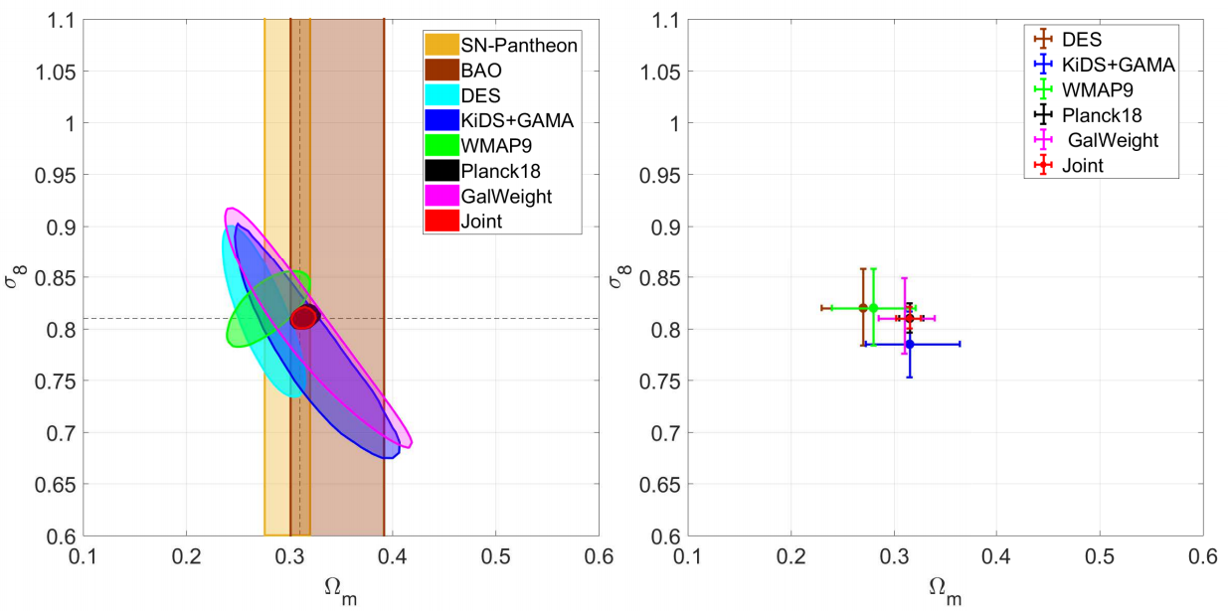
Constraining Ω_{m} and σ₈
Paper 3
Comparison with non-cluster abundance probes
The joint analysis of our results with
Planck18+BAO+SNe gives
Ωm = 0.315±0.013,
σ8 = 0.810±0.011.
Notes:
Comparison with non-cluster abundance probes.
The left panel introduces the 68% confidence level derived from our catalog (pink contour) in comparison to the results obtained from other cosmological probes including Supernova, CMB, Baryonic Acrostic Oscillation, galaxy-galaxy lensing.
As shown, the CL derived from our results overlaps the CLs obtained from all non-cluster abundance probes.
The Right panel shows the uncertainties on Ωm and σ8 for each of these studies. The scatter between the results of the different cosmological probes is small.
The red contour level represents the combination of our 68% CL with those obtained from Planck18+BAO+SNv. The joint analysis gives Ωm = 0.315+0.013 and σ8 = 0.810±0.011.

Slide 47
Current and Future work
The evolution of the richness – cluster mass relation of the GalWeight19 cluster catalogs (z ~ 0.1) and the GOGREEN galaxy clusters (z ~ 1).
The evolution of the galaxy stellar mass function (SMF) derived from hydrodynamical simulations.
Environmental effect on cluster galaxies using GalWCat19 catalog
Velocity bias between Galaxies and Dark Matter
Central stellar mass– cluster mass scaling relation of the GalWCat19
Correlation Function of Galaxy Clusters

Slide 48
Thank you
Questions

