Slide 1
Black Hole Information Paradox
Adel Awad
Centre for Theoretical Physics
British University in Egypt

Slide 2
Outline
I- Classical Black Holes
1- General Relativity
2- Schwarzschild Solution
3- What is a Black Hole
4- Do Black Holes Exist?
5- Laws of Black Hole Mechanics
II- Quantum Effects and Black Holes
1- Quantum Calculation
2- Hawking’s Argument
3- Black Hole Complementarity
4- Firewall Argument
III- Conclusion

Slide 3
I- Classical Black Holes
1- General Relativity (GR)
GR basic assumptions:
a) Equivalence Principle ⇒ geometrical description of gravity.
b) Principle of General Covariance ⇒ expressing physical laws in tensorial form.
Field Equations:
(geometry) R_{μν}- 1/2 g_{μν} R+ Λ g_{μν} = κ T_{μν} , (matter)
which is similar to Poisson's eqns.
The fundamental quantity here is the metric g_{μν}
ds² = g_{μν} dx ^{μ} dx ^{ν}.
$$^{2}=$$

Slide 4
2- Schwarzschild Solution
Solving vacuum Einstein's Eqns. with spherical symmetry, one obtains what is called Schwarzschild solution;
ds² = - (1-2m/r) dt² + (1-2m/r)⁻¹ dr² + r²(dθ² +sin(θ)² dϕ²
At r_{s}= 2m something goes wrong, it is a horizon! It divides the space into r > 2m and r < 2m.
If we squeeze the matter of a star till it goes inside r_{s}? We get what is called a Black Hole!
.
Schwarzschild
horizon
Curvature singularity
Surf. of the star
Surf. of the star

Slide 5
3- What is a Black Hole
Defintion: A black hole is a region in space which has very strong gravitational field such that a light ray emitted from its surface can not escape its gravitational pull.
Simple classical argument: (Laplace 1798)
v_{esc}= (2 G M/R)^{1/2} ⇒ c = (2 G M/R)^{1/2}
Hawking and Penrose were able to prove that singularities can occur generally in Einstein's G R.
Theorem: The only measurable quantities for a BH are the mass, charge and angular momentum. Notice the analogy between a BH and an elementary particle.
black hole

Slide 6
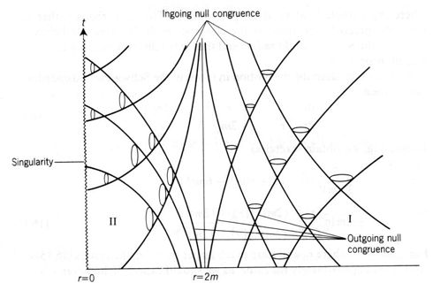
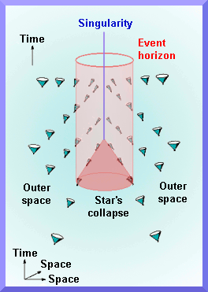
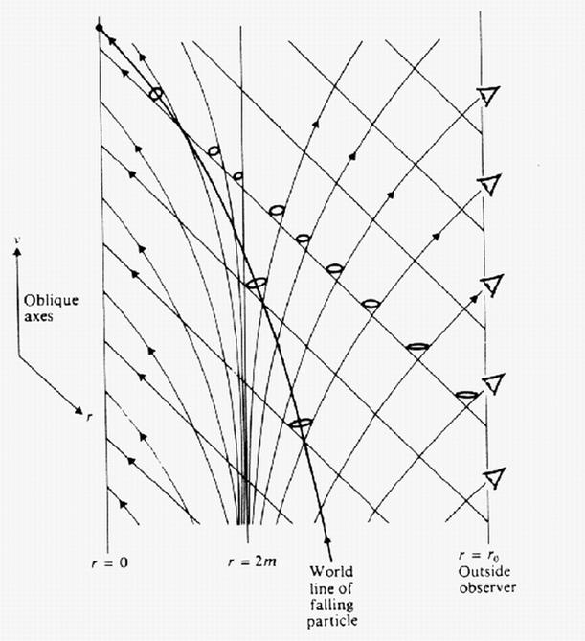
Black Hole in other Coordinates Systems
ds² = - (1-2m/r) dt² + (1-2m/r)⁻¹ dr² + r²(dθ² +sin(θ)² dϕ²
Tortoise coordinates
Eddington-Finkelstein coordinates

Slide 7
5- Laws of BH Mechanics
After studying classical BH's for years relativists were able to write down the following laws;
First Law:
d M = K dA+ Φ dq ⇔ d U = T dS- PdV
Second Law:
d A ≥ 0 ⇔ d S ≥ 0
Bekenstein in 1972 argued that the entropy of a BH S~ A ≥ 0. But can we interpret it as the statistical entropy of a BH?
This is not consistent, since a thermal object must exchange radiations with its surrounding in order to maintain any thermal equilibrium.

Slide 8
II- Quantum Effects and Black Holes
1- A Quantum Calculation
In 1975, Hawking showed that by quantizing matter fields and keeping gravity classical (semi-classical) a BH must radiates thermally due to quantum effects.
E field
BH horizon
e ⁻
e ⁺
T_{H}=1/8πGM
γ
γ
e ⁺
e ⁻
Strong E field effect
Strong G field effect

Slide 9
Later he argued that this radiation violates unitarity which shows that BH is losing information, this is known as "information loss paradox".
|out > = U |in > |in > = U ⁺|out >
The consequences are severe, either to modify QM or to show that the evolution is unitary.
Let us try to understand Hawking’s argument more clearly.
M with large S
Thermal radiation
?

Slide 10
Quantum Mechanics in Nutshell
Suppose we have a system with two energy levels:
If the system in state |↑$, i$ts energy is E_{1,}
with probability 1.
If the system in state $\text{|}\text{↓}⟩, i$ts energy is E_{2,}
with probability 1. (Eigenstates)
Physically the system can be in a state; a |↑$$+ b $\text{|}\text{}$
(superposition state)
Then; you get energy is E_{1,} with probability a² and E_{2,} with probability b².
|↑$$
E₁
$\text{|}\text{}$
E₂

Slide 11
2- Hawking’s Argument
BH horizon
Entangled state
|$$_{pure}
|$mixed$
γ
γ
|$mixed$ = U |$$_{pure} (U can not be unitary)
A mixed state: ρ_{Mixed}
A pure state: |$⟩\text{pure}$= |↑$ \text{|}\text{}$
This radiation is seen by an observer who stays static w.r.t. BH. A free falling observer will not see any radiation!

Slide 12
3- Black Hole Complementarity
Information has a precise meaning and accurate definition.
Let us assume our system has two parts A (n d.f.) and
B (m d.f.), S(A)=log(n), S(B)=log(m).
Don Page calculated the time taken by a thermal system (BH) after which it starts to reveal information; t _{Page}~ M³G²
Outside observer will detect entanglement between radiation and an earlier radiation, after this time.
Therefore, in principle one can construct the initial pure state.

Slide 13
Black Hole Complementarity
The above statement with the following assumptions is what we call BH complementarity picture:
Unitarity (information conservation)
Semi-classical approximation is adequate and we can apply QFT as long as R<< (L_{p})⁻².
Equivalence principle is valid (in-falling observer see no radiation)

Slide 14
Black Hole Complementarity
outside observer
Matter fall then thermalizes
BH
Both observers will not see any violation of laws of physics
In-falling observer sees nothing unusual and no radiation or drama

Slide 15
Complementarity Argument
earlier radiation before t_{page}
Hawking’s pair
BH
( after t_{page} )

Slide 16
4- Firewall Argument
Firewall argument (AMPS): a simple argument which states that the previous three assumptions of BH complementarity are not consistent (we have to give up on one of them)
Monogamy of entanglement: an important property for all quantum systems which insure that any of two maximally entangled particles cannot be entangled with a third one.
earlier radiation before t_{p}
Hawking’s pair
BH
( entangled )
( entangled )

Slide 17
III- Conclusion
BH information paradox is back! Of course not as strong as before, since we have gained new incite.
One of the three natural assumptions is wrong. It is not clear what to choose but for AMPS people they choose 2 or 3.
The firewall region could be a result of many things among them nonlocal QFT effects and/or trans-Planckian physics stretched up to the horizon.
We need to rethink the relation between QM and GR.

Slide 18
3- Holographic Principle
Hawking also found that BH entropy is proportional to the area of the horizon
S = 1/4 A_{h}
Using the above results, Bekenstein argued that the maximum entropy in a region of a space, with a boundary area A.
S = 1/4 A
This implies that in gravity the number of degrees of freedom grows as the area, A of the region. In contrast, in QFT S ∝ V.
Can we describe a gravity theory using QFT in one dimension less ?
During 1992-94 t'Hooft and Susskind argued that a quantum gravity theory can be described using a quantum field theory in one dimension less "holographic principle''.

Slide 19
AdS/CFT Correspondence
The statement: (Maldacena 1997) A gravity theory on anti-de-Sitter (AdS ) space is equivalent to a conformal field theory (CFT or QFT) on the boundary of such a space.
Through this we understood the following:
Gravity-side QFT-side
Gas of particles on AdS ⇔ gauge theory (confined)
(for T < 1/L) ( pure SU(N) SYM at T)
BH on AdS ⇔ gauge theory (deconfined)
(for T >1/L) ( pure SU(N) SYM at T)
If this duality is correct it would resolve the long standing paradox, but we need to test it.

