Slide 1
Dyonic Taub NUT-AdS Phases
Adel Awad

Slide 2
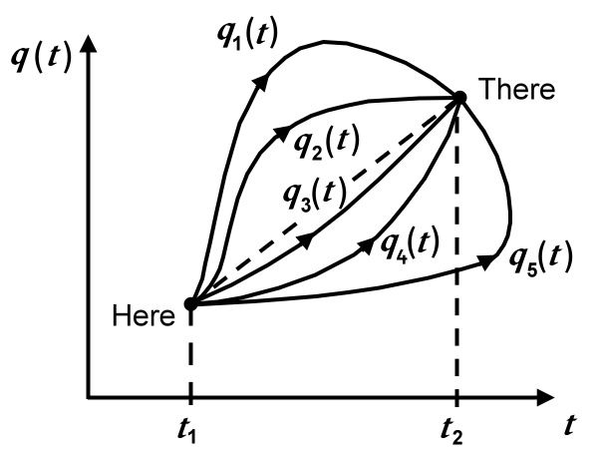
Euclidean Path Integral & Thermal Field Theory
In QM PI is defined as
⟨q_{f},t_{f}| q_{i},t_{i}⟩ = ∫D[q] e ^{i I[q] /h} = ⟨q_{f}| e ^{-i H Δt} |q_{i}⟩
q(t_{i}) = q_{i} & q(t_{f}) = q_{f}.
In QFT PI is given by
Z= ⟨φ_{f},t_{f}| φ_{i},t_{i} ⟩ = ∫D[φ] e ^{i I[φ] /h} =⟨φ_{f}| e ^{-i H Δt} |φ_{i}⟩
φ(t_{i}) = φ_{i} & φ (t_{f}) = φ_{f.}
QFT at finite temp., φ_{i}= φ_{f} and taking Δt → -iβ.
Z = Σ_{φ} ⟨φ|e ^{-βH} |φ⟩ =Tr e ⁻ ^{βH} . (in FT without gravity β is arbitrary!)

Slide 3
Euclidean Path Integral & Regularity Conditions
Z = Σ _{(g,φ)} ⟨g,φ| e ^{-βH} |g,φ⟩ =Tr e ^{-βH} . (with gravity β is not arbitrary!)
g and φ must be regular!
Expand Eucl. metric (t→iτ) around r = r_{0,}
ds² = f(r) dτ²+1/f(r) dr²+…
Where, f= f₀+f’ (r-r₀)+…
ds² = f’ (r-r₀) dτ²+1/(f’ (r-r₀)) dr²+…
dR= (f’ (r-r₀))^{-1/2} dr → R=2 [ (r-r₀)/f’ ]^{1/2}
ds² = R² d(f’τ/2)² +dR²+…
Compare with 2-dim conical space
ds² = R² dθ² +dR² ,→ β=[τ]=2[θ ]/f’= 4π/f’
r =∞
r = r₀
BH boundaries
2-dim conical space
(R,θ) coordinates

Slide 4
Euclidean Path Integral & Regularity Conditions
Gauge pot. regularity conditions;
A_{elec} =(-q/r+c) dt, as r → r₀, | A_{elec} |² =(-q/r+c) /f (reg. only if ) →
c = φ=q/r₀!
A_{elec} =(-q/r+c) dt, as r → ∞, A_{elec} =c dt (reg.) → c = φ is fixed! (grand. Canon. Ens.) since I=I(g,A)=I(g_{b}, φ).
A_{mag} =(p cos(θ)+c’) dφ, as r → r₀ is regular.
A_{mag} =(p cos(θ)+c’) dφ , as r → ∞, p is fixed! (canon. Ens.). I=I(g_{b},p).
A_{mag} =(p cos(θ)+c’) dφ , at , θ=0, π, | A_{mag} |² =(p cos(θ)+c’)² /sin(θ)², (reg. only if ) → c’ = ± p!
Work term in 1st law, φ dQ = φ d(eN) = μdN

Slide 5
Euclidean Path Integral & Statistical Ensembles
Upon ignoring quant. corrections, the PI is dominated by saddle point approximation, in this limit
Z_{Can} = exp(-I_{on-sh}) = exp(-βF), for Canon., F = U-TS (Helmholtz pot.),
or,
Z_{grnd} = exp(-I_{on-sh}) = exp(-βG), for Grand Canon., G = U-TS- μN (Gibbs pot.)
Also, internal energy and entropy are
U = -∂_{β}ln Z_{can} , S = β ∂_{β}I – I.

Slide 6
Euclidean Path Integral & Phase-Transitions
Our approach requires that we specify the boundary
values of g_{b} and A_{b} to construct thermodynamics.
I=I(g_{b},A_{b})=I(β,p,φ)
But what if we have more than one solution that have the same boundary values.
Z= exp(-I₁) + exp(-I₂) = = exp(-βF₁) + exp(-βF₂)
We might have certain range of temp. in which F₁< F₂, then this could be reversed in another range, F₂< F₁. In this case we have phase transition!
The temp. at which F₁= F₂, is the transition temp.!

Slide 7
Van der Waals Fluids:
Equation of State of real gas:
Where v=V/N, a >0, represent corrections due to attractive force between molecules and b>0, represent corrections due to size of molecules.
Which can be put as;

Slide 8
Fluid’ Behavior: P-V diagram

Slide 9
Critical Points: P-T diagram
Let us consider P=P(v), then
Critical points are solutions of
Which leads to one point

Slide 10
Behavior around Critical Points:
Critical behavior is characterized by power law behavior for certain quantities (critical exponents):
Specific heat,
Ordered parameter,
Compressibility,
Pressure at T=T_{c},

Slide 11
Gibbs Energy:
Gibbs energy is
G= μ₁N₁ + μ₂N₂, dN₁=-dN₂
dG= (μ₁ – μ₂) dN₁
At transition:
T₁=T_{2,} P₁=P_{2,} and G₁=G_{2,}
μ₁ = μ₂
For VdW fluids we get
swallowtail behaviors

Slide 12
Charged-AdS solution*
Solution:
Gravitational action, I=β G,
Temperature,
*R. Mann, et. al arXiv:1205.0559.

Slide 13
Critical Behavior of Ch-AdS:

Slide 14
Critical Behavior of Ch-AdS:

Slide 15
TN-Phases*
Metric:
For the regularity of the 1-form,
* A. Awad & E. Elkhateeb PhysRevD.108.064022

Slide 16
TN-Phases
Temp.
Gibbs Pot. (or action I=G/T)
All quantities satisfy 1st law

Slide 17
TN-Phases
Critical points (Canon. Case φ_{e}=0):

Slide 18
TN-Phases
We have two c.p’s (Canon. Case):

Slide 19
TN-Phases
Behavior of Gibbs pot. (Canon. Case):

Slide 20
TN-Phases
P-T diagram (Canon. Case): For q_{m}=$\frac{n}{\sqrt{3}}$
:

Slide 21
TN-Phases
Critical points (mixed Case, q_{m}=0):

Slide 22
TN-Phases
We have similar results to the Canon. Case for mixed Case (q_{m}=0, 1/2 < φ_{e}<1):
But for the mixed Case (q_{m}=0, φ_{e} ≥1) we have one crit. point:

